Slide 1
“Predictive Maintenance and Condition-Based Monitoring (CBM) for Maritime Drive Systems Using Machine Learning Techniques"
Nachiket Dattatraya Dixit
Email: erdnachiket@gmail.com
Course: Advance AI and ML(LBDSC25082023)

Slide 2
Content
Problem Statement
Introduction (Condition Based Monitoring & GT Propulsion System)
Data Summary
Project Approach
Exploratory Data Analysis
Base Model
Random Forest and XGBoost
Hyperparameter Tunning
Feature Importance
GT Turbine decay state coefficient Prediction
Conclusion and Recommendation
References

Slide 3
Problem Statement
This dataset records operational performance metrics of a ship's gas turbine propulsion system. Each row represents a set of measurements taken under specific conditions, likely at different times or operational states. The parameters captured include various torque measurements, rates of revolutions, temperatures, pressures, fuel flow, and state coefficients. These metrics are crucial for monitoring and analyzing the propulsion system's performance, efficiency, and maintenance needs.
The data can be used for predictive maintenance, performance optimization, and anomaly detection. By analyzing the relationship between these parameters, one can identify patterns that indicate potential issues or areas for improvement in the propulsion system.

Slide 4
Introduction
Condition-Based Monitoring (CBM) is a maintenance strategy that monitors the actual condition of equipment to decide what maintenance needs to be done. It is designed to optimize the maintenance process by ensuring that maintenance is only performed when necessary, thereby reducing unnecessary downtime and costs.
Gas propulsion systems in ships, particularly those using Liquefied Natural Gas (LNG) as fuel, have gained popularity due to their environmental and economic advantages. LNG propulsion is seen as a cleaner alternative to traditional marine fuels like Heavy Fuel Oil (HFO) and Marine Diesel Oil (MDO), offering significant reductions in emissions of sulphur oxides (SOx), nitrogen oxides (NOx), and particulate matter.

Slide 5
Data Summary
Lever position(measure in RPM-Low to High): Position of the ship's lever (range: 1.138 to 9.3).(Indicates throttle speed)
Ship speed (v): Speed of the ship, likely in knots (range: 3 to 27).
Gas Turbine (GT) shaft torque (GTT): Torque on the gas turbine shaft in kN m (range: 289.964 to 72763.329).
GT rate of revolutions (GTn): Revolutions per minute (rpm) of the gas turbine (range: 1349.489 to 3560.395).
Gas Generator rate of revolutions (GGn): Revolutions per minute (rpm) of the gas generator (range: 6677.38 to 9778.528).
Starboard Propeller Torque (Ts): Torque on the starboard propeller in kN (range: 7.584 to 644.905).
Port Propeller Torque (Tp): Torque on the port propeller in kN (range: 7.584 to 644.905).
High Pressure (HP) Turbine exit temperature (T48): Temperature at the exit of the high-pressure turbine in Celsius (range: 464.006 to 115.797).
GT Compressor inlet air temperature (T1): Temperature of inlet air to the gas turbine compressor in Celsius (constant at 288).
GT Compressor outlet air temperature (T2): Temperature of outlet air from the gas turbine compressor in Celsius (range: 550.563 to 789.094).
HP Turbine exit pressure (P48): Pressure at the exit of the high-pressure turbine in bar (range: 1.096 to 4.498).
GT Compressor inlet air pressure (P1): Pressure of inlet air to the gas turbine compressor in bar
(constant at 0.998)
GT Compressor outlet air pressure (P2): Pressure of outlet air from the gas turbine compressor in the bar (range: 5.947 to 22.811).
GT exhaust gas pressure (Pexh): Pressure of exhaust gas from the gas turbine in the bar (range: 1.019 to 1.049).
Turbine Injection Control (TIC): Control parameter for turbine injection in percentage (range: 3.879 to 92.556).
Fuel flow (mf): Rate of fuel flow into the gas turbine in kg/s (range: 0.079 to 1.832).
GT Turbine decay state coefficient: Coefficient related to the decay state of the gas turbine (range: 0.975 to 1). (Note- usually a drop of 5-10% in efficiency might be considered critical for gas turbines.

Slide 6
Project Approach
Problem Statement
Data collection and Preprocessing
Exploratory Data Analysis
Feature Selection and Outlier Detection
Modelling
Model performance and evaluation
GT Turbine decay state coefficient Prediction
Recommendation and Conclusion

Slide 7
Exploratory Data Analysis
Moderate Variability in Key Parameters: Many parameters, such as Gas Generator Revolutions and Fuel Flow, show moderate variability, as indicated by their standard deviations. This variability highlights the dynamic nature of the gas propulsion system and the need for robust monitoring and control mechanisms.
Clusters of Highly Correlated Variables: Lever Position, GT Shaft Torque, and HP Pressure Ratio form a cluster of interrelated parameters, suggesting that changes in one can significantly affect the others. Understanding these clusters can aid in predictive maintenance and system optimization.

Slide 8
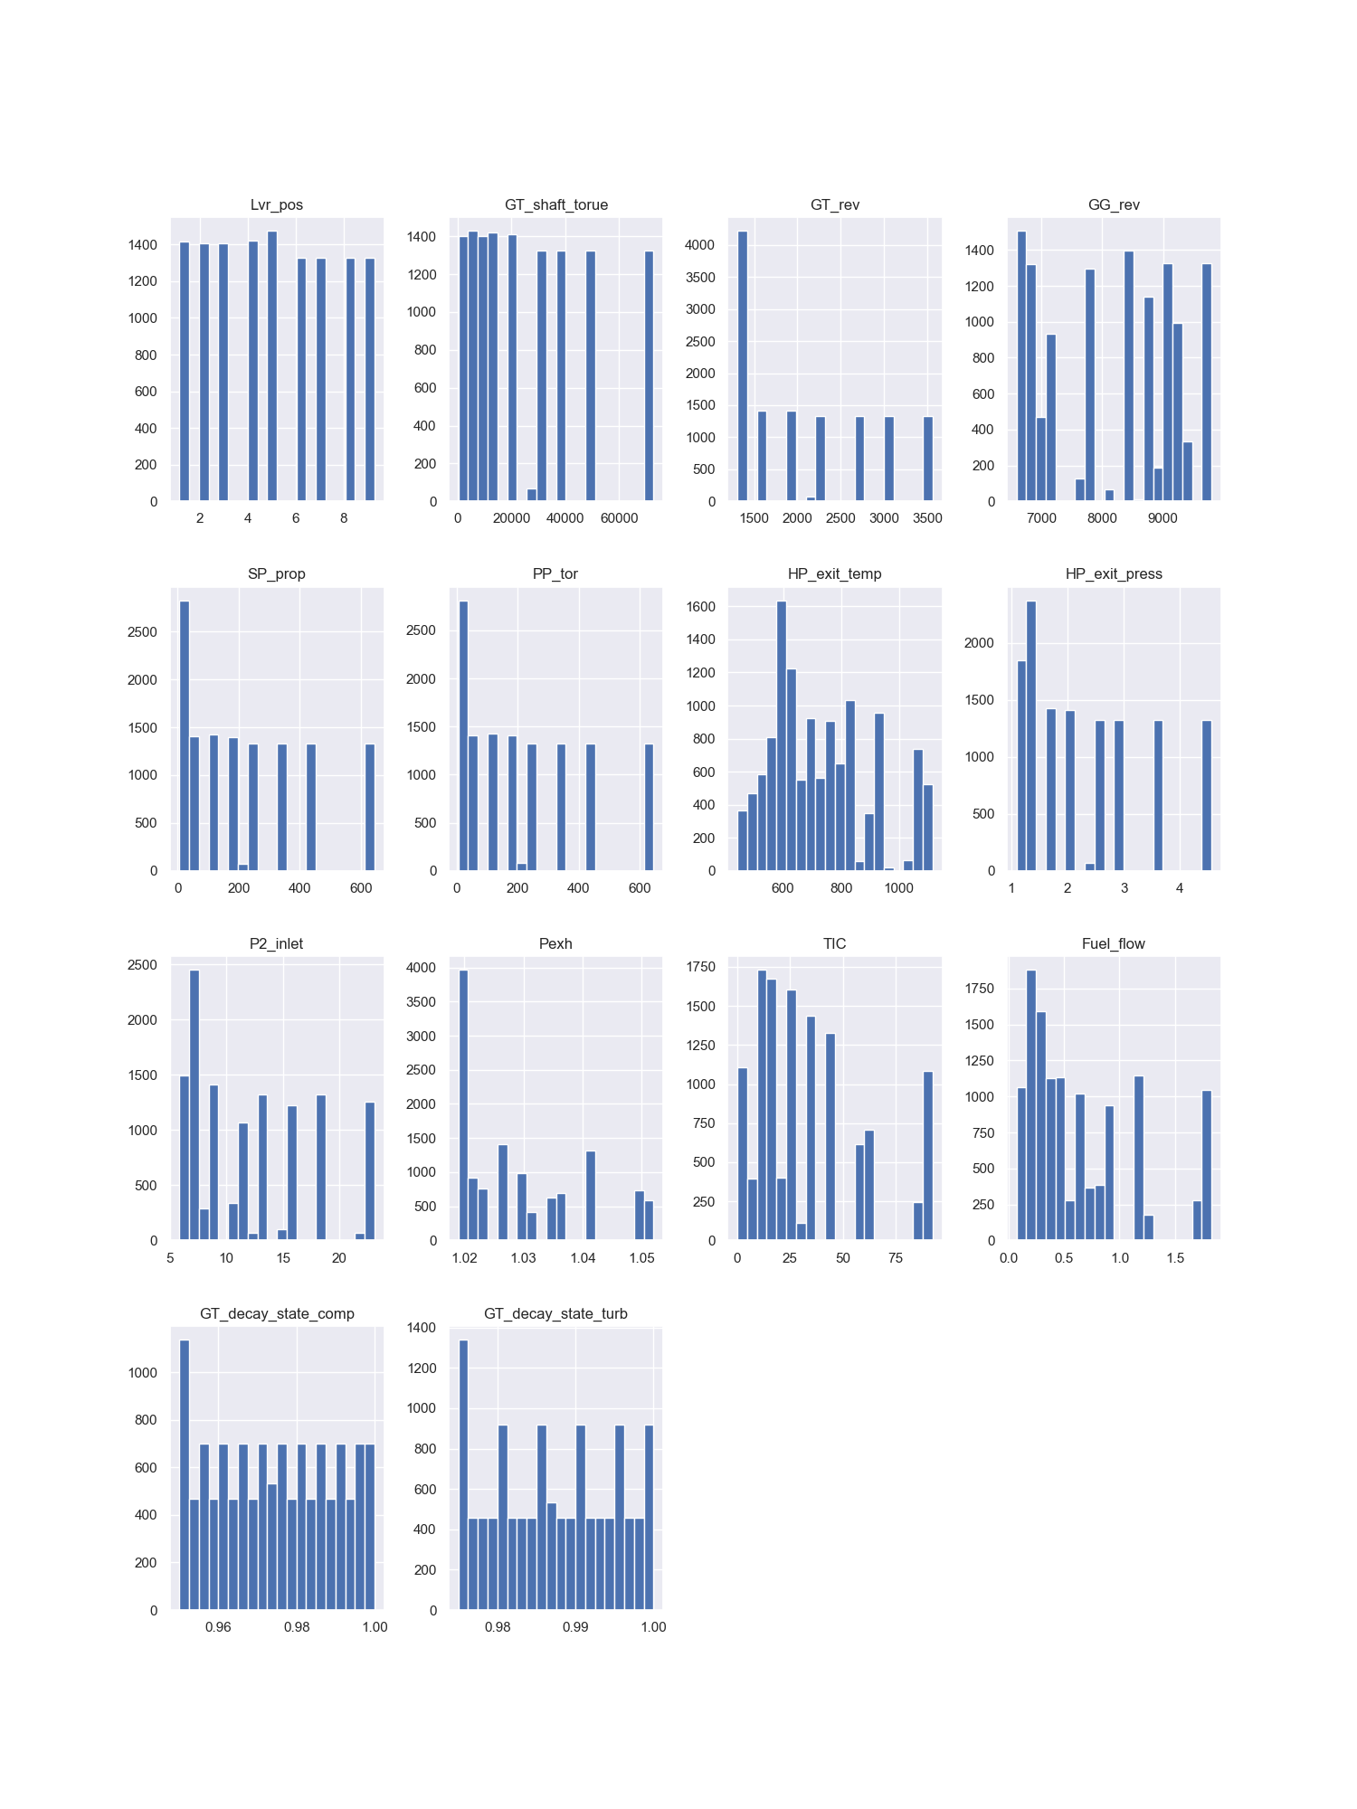
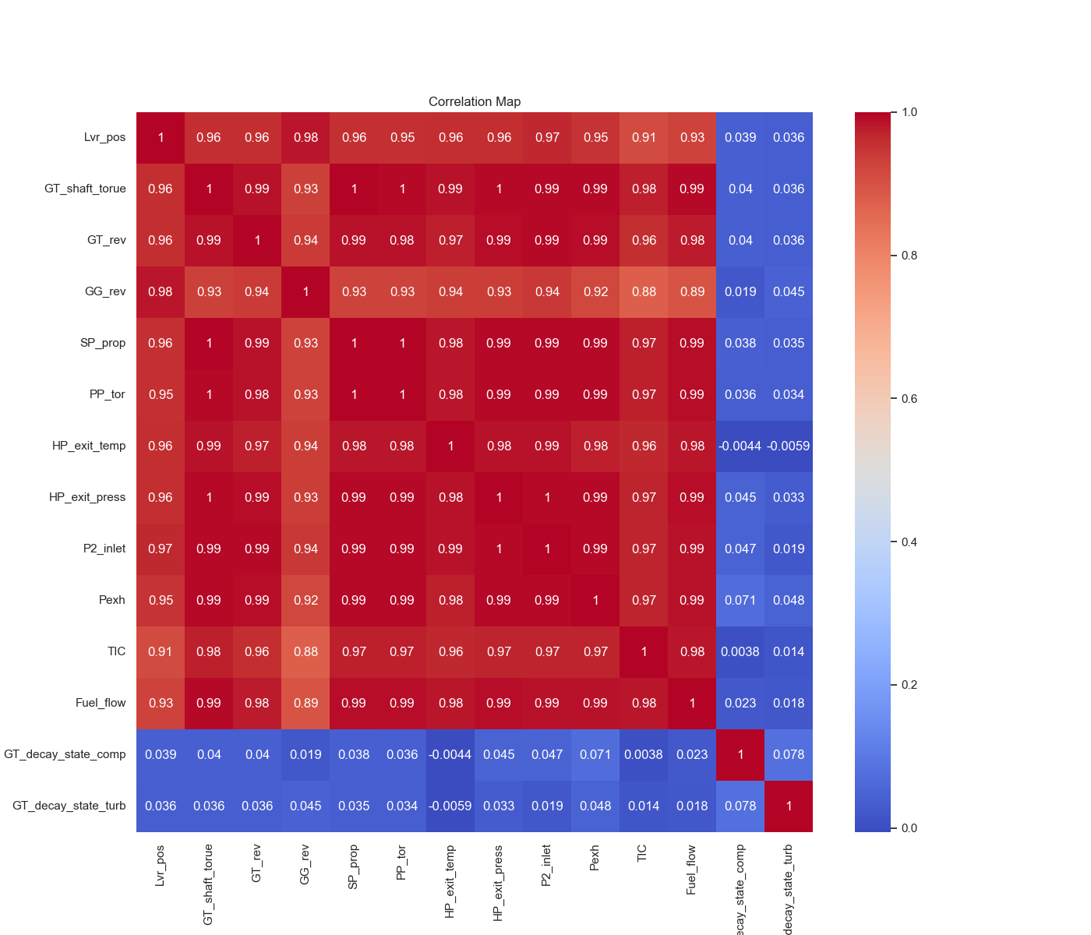
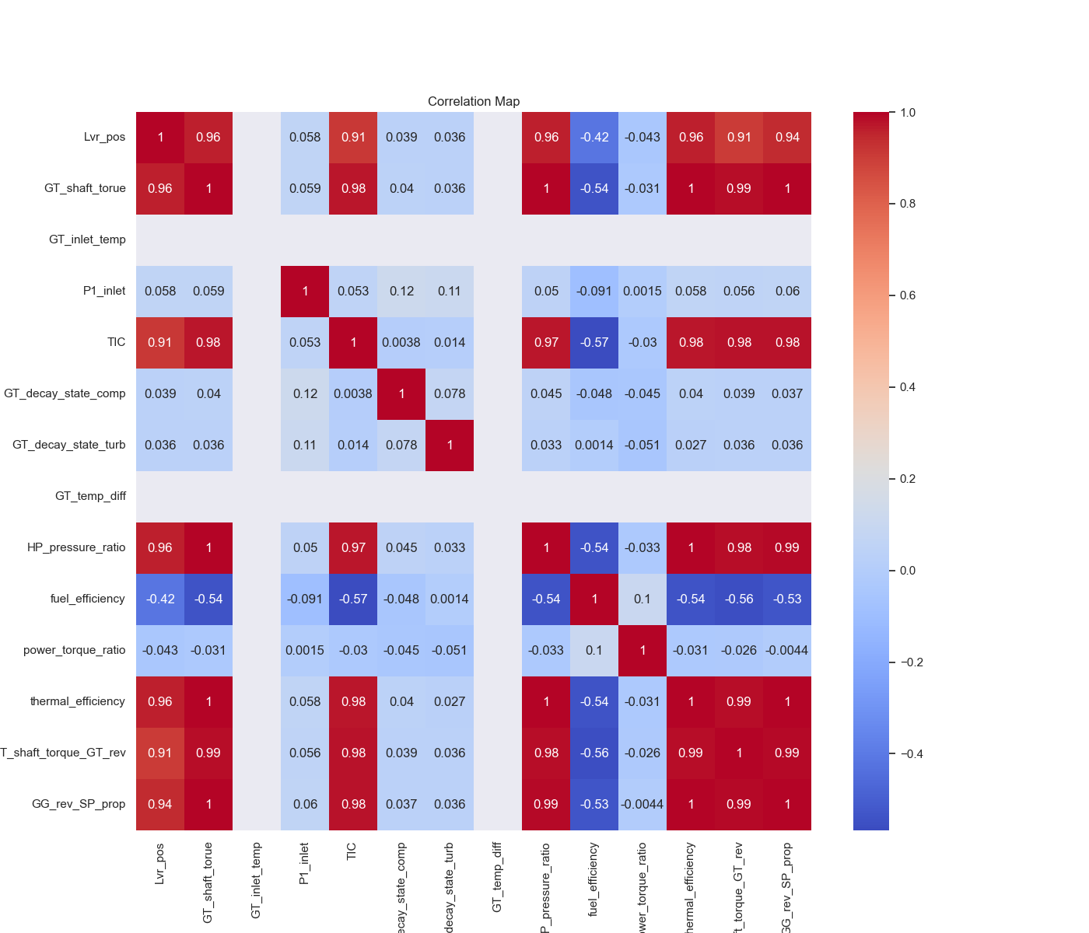
Before introducing new features
After introducing New Features
GT_shaft_torue and GT_rev: Both have a high correlation with each other.
GG_rev: Highly correlated with GT_shaft_torue and GT_rev. You can drop GG_rev.
HP_exit_temp and GT_outlet_temp: Both have a high correlation with each other.
Fuel_flow: Highly correlated with multiple features like GG_rev, GT_shaft_torue, etc.
thermal_efficiency: Highly correlated with GT_shaft_torue and GT_rev. Consider dropping thermal_efficiency.
As we can clearly, see multicollinearity in graph, we introduced new features based on domain knowledge we have. These features are: GT_temp_diff, HP_pressure_ratio, fuel_efficiency, power_torque_ratio, thermal_efficiency, GT_shaft_torque_GT_rev, GG_rev_SP_prop

Slide 9
Key Finding of EDA
Strong Positive Correlations: Lever Position (Lvr_pos) and GT Shaft Torque (GT_shaft_torue) exhibit a very high correlation (0.96), indicating that as the lever position increases, the gas turbine shaft torque also increases proportionally. This relationship is also observed between TIC and GT Shaft Torque, with a correlation of 0.98. These strong positive correlations suggest a direct and significant impact of control settings on the gas turbine's performance.
Negative correlations imply that as these parameters increase, fuel efficiency tends to decrease. This insight is crucial for optimizing fuel consumption and improving overall efficiency in the gas propulsion system.

Slide 10
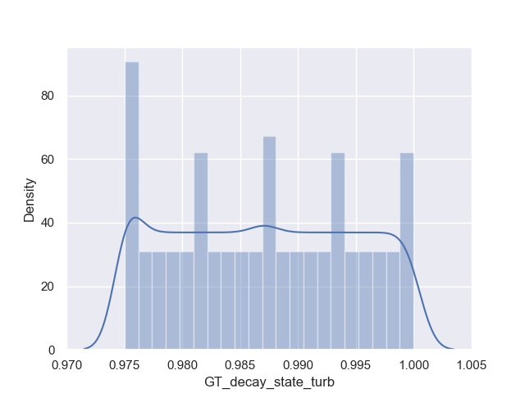
Target Variable Trend
The term "GT Turbine decay state coefficient" refers to a parameter used in the analysis of gas turbine performance, particularly in relation to how the turbine's efficiency and performance degrade over time.
Target Variable lies between 0.975 – 1.
Multiple Peaks: The plot shows several distinct peaks, indicating a multimodal distribution.
Regular Intervals: The peaks occur at regular intervals, suggesting periodic or repeating values.
Density Plot: The KDE line follows the peaks but remains relatively flat between them, reinforcing the presence of multiple modes.

Slide 11
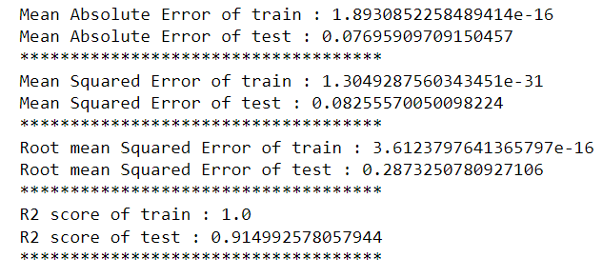
Base Model Decision Tree Regressor
The extremely low MAE on the training data indicates that the model is almost perfectly fitting the training data. The test MAE is also low, suggesting good generalization to unseen data.
Similar to MAE, the near-zero MSE on the training data points to a perfect fit. The test MSE being low, though higher than the train MSE, still indicates the model is performing well on new data.
The RMSE values support the findings from MAE and MSE, with training RMSE being almost zero and test RMSE remaining relatively low, signifying that the prediction errors on test data are minimal.

Slide 12
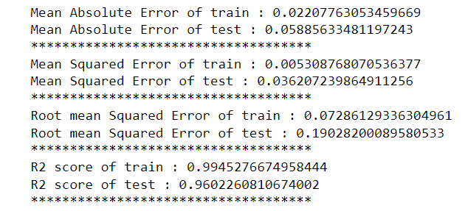
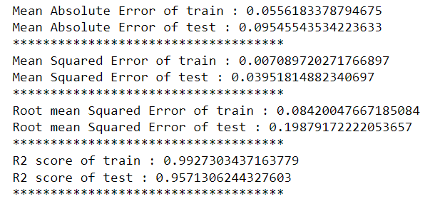
Random Forest and XGBoost
Random Forest Regressor
XGBoost

Slide 13
Hyperparameter Tunning
Best parameters for dtree: {'dtree__criterion': 'squared_error', 'dtree__max_depth': None, 'dtree__max_features': None, 'dtree__min_samples_leaf': 2, 'dtree__min_samples_split': 5, 'dtree__splitter': 'best'}
Mean Absolute Error on train set for dtree: 0.023278892893666674
Mean Absolute Error on test set for dtree: 0.08042680980364758
R² score on train set for dtree: 0.9935389708770237
R² score on test set for dtree: 0.9211573095573835
---------------------------------------------------------------
Best parameters for rfr: {'rfr__max_depth': None, 'rfr__n_estimators': 300}
Mean Absolute Error on train set for rfr: 0.021645327299635496
Mean Absolute Error on test set for rfr: 0.05807579472844295
R² score on train set for rfr: 0.9949232360101776
R² score on test set for rfr: 0.9639279506320654
---------------------------------------------------------------
Best parameters for xgb: {'xgb__learning_rate': 0.008, 'xgb__max_depth': 14, 'xgb__n_estimators': 400}
Mean Absolute Error on train set for xgb: 0.09595240935770487
Mean Absolute Error on test set for xgb: 0.12429899262348447
R² score on train set for xgb: 0.9747542149120977
R² score on test set for xgb: 0.9390805378006288

Slide 14
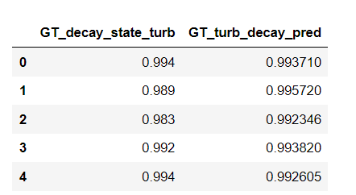
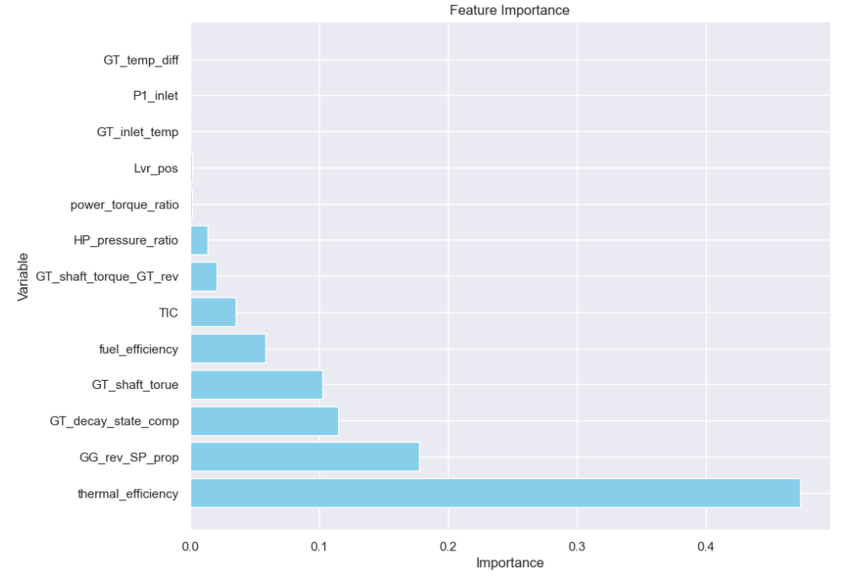
Prediction & Feature Importance
Let’s see first five rows of prediction;
Feature importance: -

Slide 15
Recommendation and Conclusion
Given that thermal efficiency has the highest importance according to feature analysis, it is crucial to routinely evaluate this metric to monitor the turbine's performance in relation to its wear and degradation. Adopting proactive maintenance strategies will help address and reduce efficiency losses caused by wear and tear.
The dataset provides several key performance metrics, including efficiency, power output, and ratios. Regular monitoring of these metrics can help identify trends, potential issues, and areas for improvement.
Performance metrics like thermal efficiency and fuel efficiency highlight the need for ongoing maintenance and optimization. Regular assessments can help maintain optimal performance and prevent costly downtime.
The ratios and products calculated can inform operational adjustments to improve efficiency and performance. Use these insights to guide decision-making and operational strategies.

Slide 16
Thank You

